Slide 1
War Stories: Unrealistic Timelines and Unanticipated Roadblocks
Continuing Education Class

Slide 2
Agenda
Section 1 – Roadblocks to Closing
Section 2- The 11th Hour and Closing
Section 3 – Post-closing Claims and Repercussions from Quick Closings

Slide 3
Roadblocks to Closing

Slide 4
Fraud in the Chain
Abandoned property is owned by an Arkansas LLC but the vesting deed into the LLC did not list the home state
A few years later there is a quitclaim deed from the LLC to a new owner. The property was then sold to the current owner.
During the title exam we noticed that the LLC was not an active LLC with the GA SOS until years after they purchased the property.
A Georgia LLC was created with the exact same name as the Arkansas LLC. The Georgia LLC then “sold” the property owned by the Arkansas LLC.
The Arkansas LLC still owned the property and current owner did not have title to convey. Owner had to file a title claim.

Slide 5
Lessons:
A company must be registered with the Secretary of State at the time the company takes title to the property;
Check a company’s status, their date of organization, etc. on the Secretary of State’s website: https://ecorp.sos.ga.gov/BusinessSearch; and
List the state of incorporation in the vesting language on the deed
language on the deed

Slide 6
Estate Heirs
Property was unimproved land purchased by Dad in 1981. Dad passed away in the early 2000’s.
Mom was named executrix of Dad’s estate. Mom passed away around 2008.
In 2018, Mom as executor of Dad’s estate signed a deed selling the property for $15,500 to an individual
this was the forgery – obviously, she didn’t sign BECAUSE SHE WAS DEAD!
That individual then transferred title into his LLC and his LLC sold the property to a builder for $70,000.
Builder constructed a $500,000 home on the property and in 2021 contracted with a Buyer to sell the property for $573,500.
We discovered the forgery in our title exam. Builder filed a claim with title insurance.
The administrator of Dad’s estate claimed that they should be paid the value of the property with the improvements. Title insurance negotiated a $90K payout with the administrator. Builder’s policy was only $70K and it was a standard policy. Builder had to bring an additional $20K to the deal.
Part of settlement was for the estate and heirs to sign quitclaim deeds. The estate signed their deed but the heirs held out signing. They only agreed to sign deeds if they did not have to make any payments to administrator for his time, so buyer ended up paying administrator’s fees to allow transaction to move forward.

Slide 7
Lessons
Title Insurance is important!
Without title insurance the builder would have to negotiate with the heirs himself and pay the entire settlement out of pocket.
We cannot issue an enhanced title insurance policy on raw land. The GAR contract directs us to issue an enhanced policy, when available. However in this case the builder could only get a standard policy.
An enhanced policy grows 10% in value every year for the first 5 years. It ends up being worth 150% of its face value!
If you are purchasing raw land with plans to build let us know so we can add a future improvements clause to your standard OTP.

Slide 8
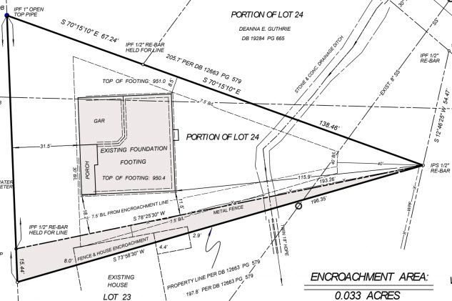
Neighbor’s House on the Property
Survey showed that the neighbor’s fence was 15 feet over the property AND the neighbor’s house was 8 feet over!
Seller knew about the encroachment and did not disclose it or try to resolve it.
Buyer and Seller were willing to quitclaim the encroachment area to the neighbor but the city wouldn’t approve.
Neighbor wouldn’t sign an encroachment agreement.
Seller and neighbor were negotiating a boundary line agreement but attorneys got involved on both sides and it was going to take months to resolve.
Buyer would not sign any more extensions and terminated because Seller couldn’t provide good and marketable title.
Regardless of the timeline Buyer was not obligated to accept a boundary line agreement.

Slide 9
Lessons
Surveys are vital! A visual inspection of the property alone wouldn’t reveal this encroachment.
A buyer isn’t obligated to accept an encroachment agreement, easement, etc. and has the right to terminate due to a title objection up until closing!
You must have planning/zoning approval before selling off a portion of your property.
Disclose, disclose, disclose!

Slide 10
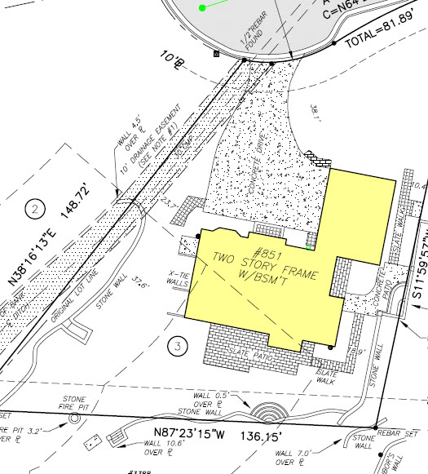
Encroachments on a Survey
The survey showed encroachments on all three sides of the property. Title underwriters required a special exception for these encroachments in the title policy
Seller can no longer convey good and marketable title as defined in the GAR contract.
The seller could not remove the encroachments in time for closing but was willing to get an encroachment agreement from the neighbors. The buyer would not accept an encroachment agreement.
Seller later remembered they had a very old survey that showed these encroachments. They had forgotten about that survey and thus failed to disclose the encroachments.
Buyers have a right to terminate for title objections up until closing and are under no obligation to accept an encroachment agreement.

Slide 11
Lessons
Surveys are vital! A visual inspection of the property alone wouldn’t reveal these encroachment.
A buyer isn’t obligated to accept an encroachment agreement, easement, etc. and has the right to terminate due to a title objection up until closing!
Disclose, disclose, disclose!

Slide 12
Lien in the Gap
Seller purchased the condo a few months prior.
Our title exam pulled a FIFA against the prior owner that was not paid off at the closing earlier in the year.
The face value of the FIFA was approximately 70% of the current sales price.
FIFA was filed one day before their closing, so it fell in the “gap” of the title exam. There was no way the prior closing attorney could have caught it.
Current owner made a claim on their title insurance policy. Title insurance paid the FIFA almost immediately and we were able to close on time.
Lessons:
Title insurance is important! Even the most diligent closing attorney wouldn’t have been able to find this FIFA.
Without title insurance the seller would have to go after the prior owner directly to try to recover.

Slide 13
Lost Legal Description
The 1997 vesting deed referenced the legal description attached as Exhibit A but there was no Exhibit A attached. The owner lost all original closing documents in a fire.
The title exam also showed a Declaratory Judgment action filed by the current lender to reform the legal description so they could foreclose. Complaint provided a street address for prior owner – or at least the address of someone with the same name.
We sent a Quitclaim Deed via FedEx with a letter explaining the current status of title, the pending declaratory judgment, and a request that, if they were the prior owner of this property, they please sign the deed before a witness and notary and return it to us via the prepaid FedEx label.
Listing Agent did some skip-trace research and found several phone numbers for person(s) with the same name as the prior owner. Listing Agent called all of them and on the last try, got the right person. The Listing Agent explained the situation for him again and he signed the deed and returned it to us for recording.
Continued…

Slide 14
Lost Legal Description
In the meantime, the title underwriter said we could only close this property one of two ways:
1) if the prior owner signed the deed; or
2) the Declaratory Judgment reformed the prior deed with missing legal description.
Obviously, option (2) would have delayed closing for several months, possibly with Purchaser terminating the deal.
Fortunately, the prior owner signed the quitclaim deed so we could satisfy option (1).
Lessons
If the original deed and title insurance policy weren’t lost in a fire, given the age of the deed, the title insurance underwriters may have agreed to insure it without tracking down the prior owner.
Keep an electronic copy of your important documents!

Slide 15
Hiking in Afghanistan
Husband went hiking in Afghanistan and was taken hostage by the Taliban
There has been no word from him since and his phone last pinged in Kabul three weeks ago
He did not make any contingency plans, sign a POA, etc. before leaving
Wife is now facing foreclosure, but she can’t sell because her husband is on title
Even if he signed a POA before leaving the POA would not be sufficient for the sale of the property
A POA is only valid during your lifetime and there was no way to confirm if: 1) he is alive; and 2) if he approves of the sale
Wife would ultimately need to petition the court to give her authority to sell.
Lessons:
If you are going abroad make a plan for the sale of your house before you leave – it is cumbersome to have documents notarized while abroad.
A POA can only be used during the owner’s lifetime – we must be able to verify they are alive, well, and that they approve of the sale.
Maybe think twice before planning a hiking trip to Afghanistan

Slide 16
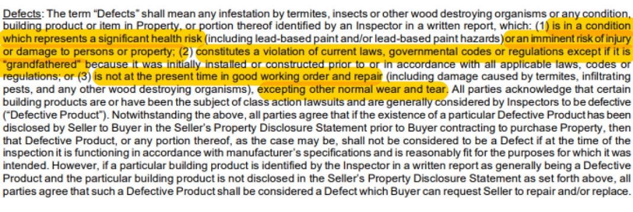
Right to Request Repairs
Under the right to request repairs you can only request repairs for “Defects” as defined in the contract.

Slide 17
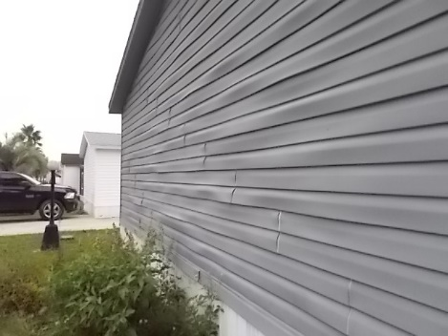

Right to Request Repairs
If the Seller already disclosed the defect the defective product does not give the Buyer the right to request repairs if:
The defective product is disclosed in the Seller’s disclosure;
The Seller’s disclosure is provided to Buyer before the acceptance date of the contract; and
The defective product is functioning according to the manufacturer’s specifications and is reasonably fit for the purpose of which it was intended.

Slide 18
The 11th Hour and Closing

Slide 19
Mulch
Four days prior to closing on new construction, buyer has surveyor go stake the lot. The surveyor finds that the neighbor’s chain link fence is encroaching on our property by 3 feet.
Builder offers to pay for the removal and new construction of a chain link fence on the actual property line and the neighbor agrees.
Buyer then hires an attorney two days prior to closing. Attorney claims that the grading on the side yard is not in conformity with the site plan.
However, the city issued the CO, which means that the home was built in substantial compliance with the site plan.
Builder gets a quote for $4,000 for a retaining wall to cure the alleged grading issue and offers buyer $5000 in closing costs.
Buyer rejects this and buyer’s attorney claims that the mulch running off the side yard will be a “continual trespass” onto the neighbor’s property (you see where this is going…). The neighbor has no objection.
It is clear buyer just wants out. Earnest money was $25,000. The builder agreed to let the buyer walk for $12,000; he was DONE with these folks.

Slide 20

Association Concerns
Buyer, right before closing discovers that the HOA does not permit owners to plant seasonal flowers in their front yard.
This is a deal breaker for the Buyer and he wants to terminate but doesn’t have the right to terminate.
Lesson:
Ask for all association documents in advance or during due diligence.
Make sure your request includes all rules and regulations. The declaration alone won’t have all the rules.
This is especially important if a buyer has a particular concern.

Slide 21

Association Concerns
14 day rush closing with no financing contingency, but the Buyer is getting a loan.
In the condo questionnaire the association discloses pending litigation between the association and two units.
This is not a title defect, but the lender’s underwriters need more information from the association to clear up their concerns.
Association does not provide lender with requested information in time, lender does not have clear to close, and the contract terminates.
Parties dispute the earnest money. Buyer says Seller is in default because the Seller’s association didn’t provide the requested documents. Seller says there was no financing contingency and this was not a title defect so Buyer is in default.
Different lenders will have different concerns and restrictions. We’ve closed numerous loans in this building without issue.
Due to the short timeline the lender did not have time to investigate their concerns and buyer did not have time to find alternative financing.

Slide 22
Deer
On the day of closing a deer died on the driveway
Buyer claimed that the dead deer meant that the property was NOT in substantially the same condition as it was on the Binding Agreement Date
The Purchase and Sale Agreement, says the Property must be in substantially the same condition as it was on the Binding Agreement Date but this is really in regard to the improvements.
To avoid fighting it out Seller scrambled and hired someone to remove it.

Slide 23
Paternity
Seller was the estate of an NFL athlete
He died young and intestate with an 8-figure estate
Under intestate succession, his parents were his only heirs
Two days prior to closing a paternity suit was filed against the estate
After the estate administrator nervously permitted a DNA test the results were NOT a match
Closing was able to proceed, albeit delayed

Slide 24
Forbearance & Divorce
Divorce Settlement Agreement says Party A shall be responsible for all mortgage payments from xx/xx/xxxx (date) until the house is sold. Net proceeds are to be split at closing.
Loan has been in forbearance and Party A did not make any payments during that time.
Payoff is much higher because of the deferred forbearance payments. This significantly reduced the net proceeds to be split between A & B.
Party B says the deferred loan payments should come from Party A’s proceeds
Party A says that since no payments were due during forbearance, they did not violate the Settlement Agreement.
Lesson:
Our hands are tied. We can only follow the terms of the settlement agreement, including how “net proceeds” are defined.
In this case, to avoid breaching their contract, Party B agreed to close with the full payoff coming from the “net proceeds” and then sued Party A for reimbursement after closing.

Slide 25
The “Murder File”
The day before closing Seller calls and says, “[w]hen I purchased the property there was a cloud on title. The title insurance people said I should let you know that there was a claim when I sell the property.”
We call the underwriter and as soon as the property address was said her immediate reaction was “oh this is the murder file.”
In the early 90s husband and wife owned the property as JTWROS. They did not have any children together. Wife died and husband sold the property a few years later.
Over 20 years later husband was arrested as a suspect in a murder case. He confessed to the murder he was arrested for and then also confessed to murdering his wife years ago. There was never any suspicion of foul play in her death.
Under Georgia’s “slayer statute” this dissolved the original JTWROS so deceased wife’s estate still held a 50% interest in the property. Seller had to file a title claim to divest deceased wife’s estate’s interest.
Fun fact: there was later an Investigation Discovery episode on his confession.
Lesson:
Title insurance is vital!
The most diligent title examiner or closing attorney would not be able to discover this title defect. Especially when the husband didn’t randomly confess until over 20 years later.
Title insurance paid the estate hundreds of thousands of dollars to release their interest in the property!

Slide 26
Post-closing Claims and Repercussions from Quick Closings

Slide 27
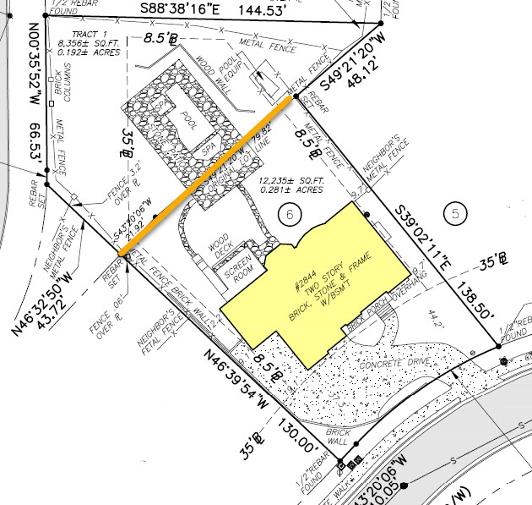
Property Line Crosses the Pool Deck
Property was originally two parcels. The second parcel was purchased later for the purpose of building the pool. The parcels were never combined in the tax record and had separate addresses.
Property closed (not with C&B) and the legal description only included the parcel with the house.
Solution? Track down the prior owners who still technically own the pool to get a quitclaim deed from them.
Prior owners moved to Turkey after closing and are now divorced and live in different cities. They had to make an appointment at the US Embassy to sign the quitclaim deed.

Slide 28
Inspection Concerns
Buyer’s inspection raised concerns but due to either the short closing timeline or lack of a due diligence they didn’t dig any deeper.
Buyer moves in and gets a quote to fix the problems. It is significantly more than Buyer anticipated. Of course, you are their first call.
Protect yourself! If there are issues or concerns on an inspection do NOT offer your opinion as to the seriousness of the problem, the cost to fix the problem, etc. Document in writing that you recommend your Buyer consult with an expert in that field to answer any questions.
If asked for a vendor recommendation, provide a list of qualified vendors and let them choose.
Remember! After closing a seller can only be held responsible for hidden, latent, material defects. If it showed up on an inspection report it isn’t hidden!

Slide 29

Unpermitted Work
Either the seller didn’t know about it so they couldn’t disclose the unpermitted work; or
Seller knew about it, didn’t actively conceal it, and the Buyer could have discovered it.
Permits are public record and many jurisdictions provide online access.
The Buyer may be required to tear down the unpermitted work or spend significant sums to bring it up to code.
Although it may have been to code when built because the work was unpermitted it is not “grandfathered”. This can be a very expensive undertaking!

Slide 30

Broken Microwave
During the temporary occupancy the microwave breaks.
Sellers say this is normal wear and tear.
Buyers say the sellers needs to replace the microwave because they broke it.
Neither party would concede so the agents ended up buying the replacement microwave so they can put it behind them.
Remember! The temporary occupancy states that the buyer is responsible for all repairs during the temporary occupancy.
Seller is only responsible for the damage they cause, excluding normal wear and tear.
If this is a concern, you can have the seller purchase a home warranty for the buyer or use a special stipulation that at possession the property will be in or substantially in the same condition as of the binding agreement date.

Slide 31

Occupancy “Rules”
Seller is elderly and moving to Florida to be closer to family. House is discounted significantly because it indeed needs some TLC.
At closing, buyers presented a laundry list of demands to the seller for the temporary occupancy period. Including but not limited to:
Upon entering the house, all shoes must be taken off, immediately at the front door (booties not acceptable);
Hand sanitizer upon entry for everyone;
Bathrooms cannot be used by the public, estate sale staff or Amvets;
No use of kitchen facilities;
No food or drinks permitted inside the house;
If children are present, they must be closely supervised by an adult;
The driveway must be protected from oil stains; and
No vehicles over 7500lb. in driveway.
Since it was cash closing, our office advised to wait to close until seller vacated.
Nonetheless, the parties wanted to go ahead and close with a security deposit for the temporary occupancy (buyers originally wanted $25K but settled on $10K).

Slide 32
Occupancy “Rules” Continued
When the occupancy ended the Buyers complained of 12 things including:
Garage door opener: Only one side of the garage door has an opener, not both. The side that doesn't work is the preferable side for backing out.
The basement exterior door deadlock key is lost. Seller originally left it in the house for the Buyer.
“Excessive” picture hook holes on every wall and screws/nails.
Damage and cracking to the driveway from vehicles. Tire marks and concrete scrapes indicate oversized vehicles.
Sellers – despite the ridiculousness of the complaints – gave $3000.00 because an interpleader action would cost at least that.
Lesson: If the parties want a security deposit use GAR Special Stipulation 416. Neither us nor your brokerage are set up to handle disputes over the security deposit. This should be handled between the buyer and seller – don’t get in the middle of it!

Slide 33
Buyer’s Remorse
During the pandemic years buyers turned a blind-eye to many things that would normally be a deal breaker for them.
Desperate to find a house they waived everything and offered huge amounts over asking. Now time has passed, they are settled in, and they realize this house won’t work for them.
Protect yourself! Document, document, document! If you document in writing anytime a buyer waives contingencies against your advice or offers extreme terms you are much better protected if they come back to you later.
If the property was financed as their primary residence, they must occupy the home as their principal residence for at least a year before renting it.
If they sell in less than 2 years they may be subject to capital gains.

Slide 34
Questions?
Attorneys@campbellandbrannon.com

